Slide 1
Climate

Slide 2
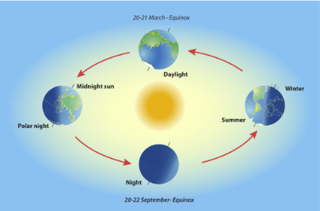
Earth's climate is determined by the amount of solar energy retained in the atmosphere. Less solar energy reaches the poles, making them cold. More solar energy reaches the equator, making it hot.
The Earth's molten core and radioactivity also contribute to the climate by releasing heat from within.
Earth's tilt also affects the climate. The Earth is tilted at an angle of 23.5º, so for six months the Northern Hemisphere receives more solar energy than the Southern Hemisphere. This makes it summer in the North while it's winter in the South.

Slide 3
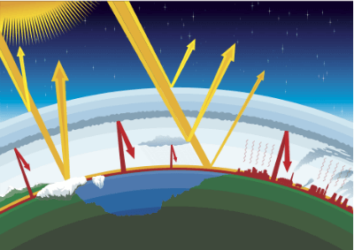
The Earth's energy balance is the sum of energy entering the Earth's atmosphere and energy leaving. When the energy balance is 0 J, the Earth has a constant temperature.
The Earth emits more energy from the molten core and radioactivity into the atmosphere than it receives in the form of solar energy. However, reflection, absorption and radiation in the atmosphere means that the Earth doesn't lose all this energy.
However, pollution in the atmosphere has increased the amount of energy which is reflected and absorbed, so less energy leaves the Earth. This increases the amount of energy in the Earth system, raising its average temperature.

Slide 4

Wind is caused by convection cells, which are created by temperature differences between the poles and equator.
Hot air at the equator rises and moves towards the tropics, where it cools down and sinks. The cooler air at the tropics then moves towards the equator, forming convection cells.
The same process happens between the tropics and the poles.
Clouds and storms develop at the equator and tropics where the air rises.

Slide 5
